Slide 1
TYPES OF PRECIPITATION
4th Six Weeks Science

Slide 2
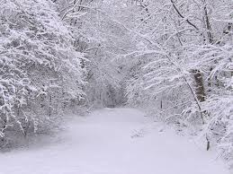
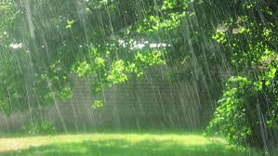
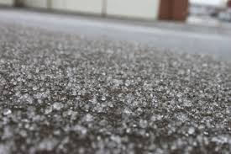
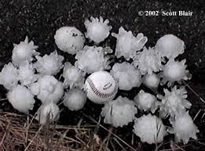
4 TYPES OF PRECIPITATION
Rain
Snow
Sleet
Hail

Slide 3
RAIN
Falls from clouds in the sky in the form of water droplets.
Part of the water cycle.
Falls visibly in separate drops.

Slide 4
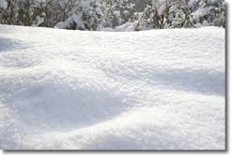
SNOW
Water vapor frozen into ice crystals
Falls from clouds as snowflakes
Lies on the ground as a white layer

Slide 5
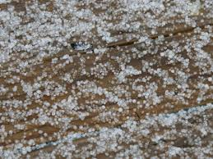
SLEET
Ice pellets mixed with rain or snow.
Occurs during winter weather.
Generally tiny in size.

Slide 6
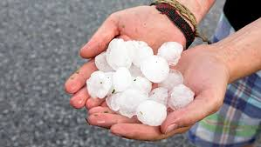
HAIL
Pellets of frozen rain that fall in showers.
Occurs during severe weather.
Balls or irregular lumps of ice, called a hailstone.

